Slide 1
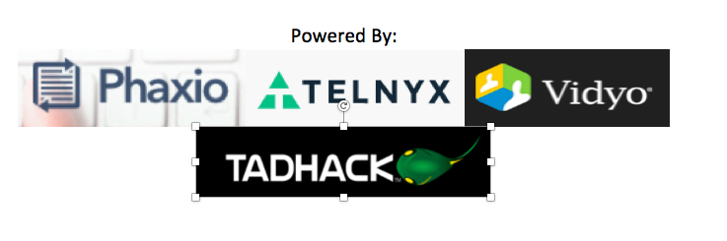
AICollab Github For Doctors
Abhishek Bhardwaj
IIT Graduate Student

Slide 2
AICollab- GitHub For Doctors
WHY?
Surgery Planning Time
Sources :https://academic.oup.com/imaman/article-abstract/16/3/281/757316
Global/Local Collaberation
Sources :https://academic.oup.com/imaman/article-abstract/16/3/281/757316
No Generic System to connect with CRMS

Slide 3
AICollab- Business Model (Motivation)
WHY?
NO one is there in Communication industry in Medical(18 Trillion $ market)
Deep Learning group cases help reduce the waiting time for surgeries (Clustering Similar Cases reducing planning time)
More surgeries more patients (in developing countries) more revenue
Better and Fast health care

Slide 4
Architecture
USA
Pipeline
(Azkaban, Ooze)
AICollab
HealthCare CRMS/ERP
India
(Flask , Django , AngularJS)
DeepLearning : TensorFlow/Theano

Slide 5
DEMO TIME

